Slide 1
CS 304 Compiler Design
Intermediate Code Generation

Slide 5
Important IR properties

Slide 6
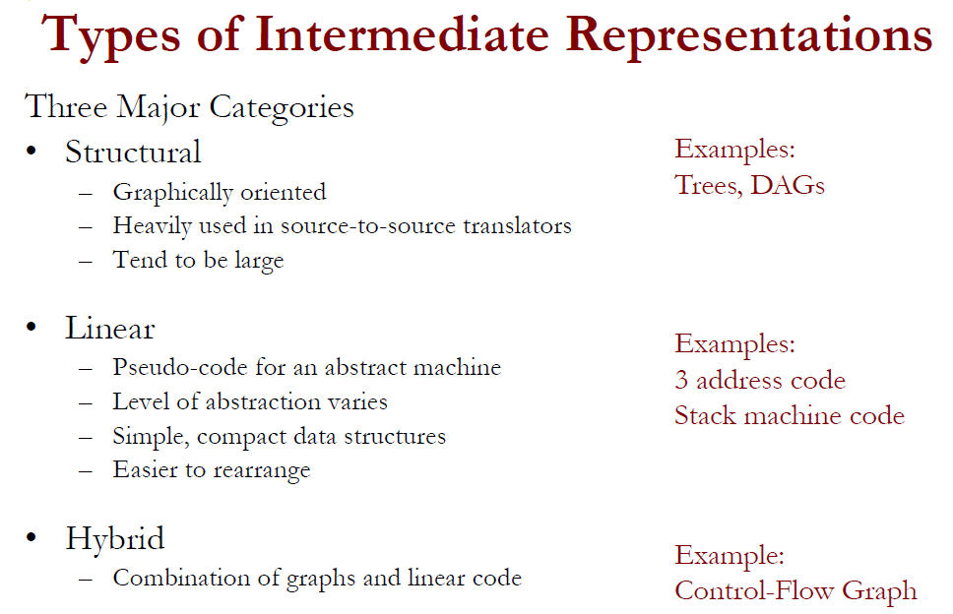

Slide 7
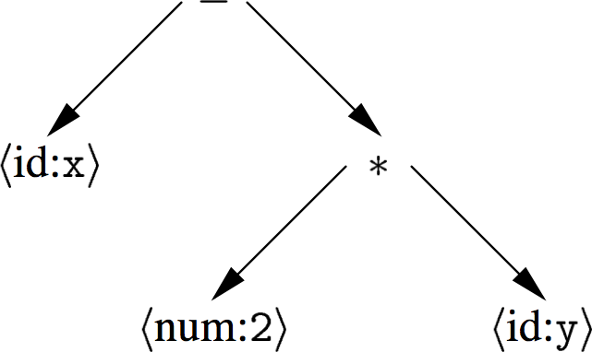
Abstract syntax tree
An AST is a parse tree with nodes for most non-terminals removed.
Since the program is already parsed, non-terminals needed to establish precedence and associativity can be collapsed!
redundancy in
Representation
x × 2 + x × 2 × y
A linear operator form of this tree (postfix) would be:
x 2 y * -

Slide 8
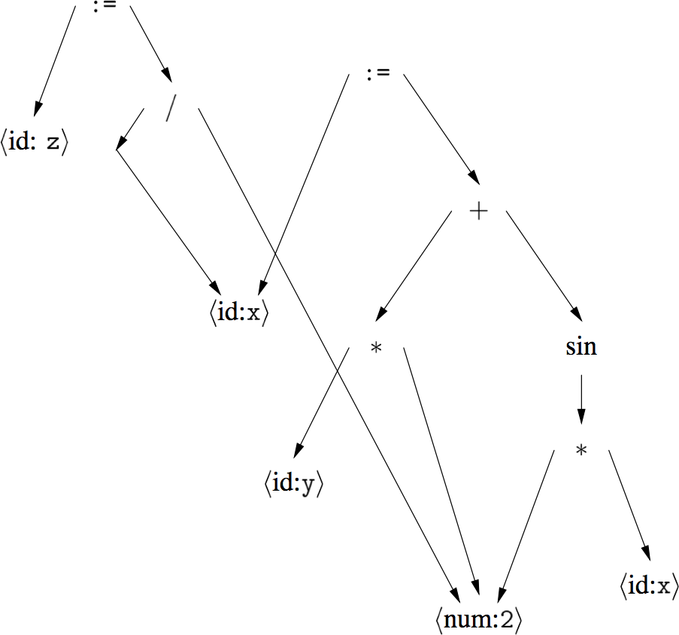
Directed acyclic graph
A DAG is an AST with unique, shared nodes for each value.
x := 2 * y + sin(2*x)
z := x / 2

Slide 9
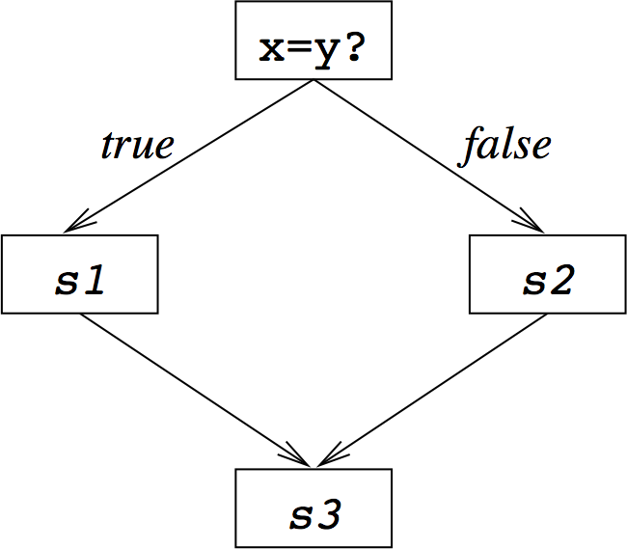
Control flow graph
A CFG models transfer of control in a program
nodes are basic blocks (straight-line blocks of code)
edges represent control flow (loops, if/else, goto …)
if x = y then
S1
else
S2
end
S3

Slide 10
3-address code
Statements take the form: x = y op z
single operator and at most three names
t1 = 2 * y
t2 = x – t1
x – 2 * y
Advantages:
compact form
names for intermediate values

Slide 11
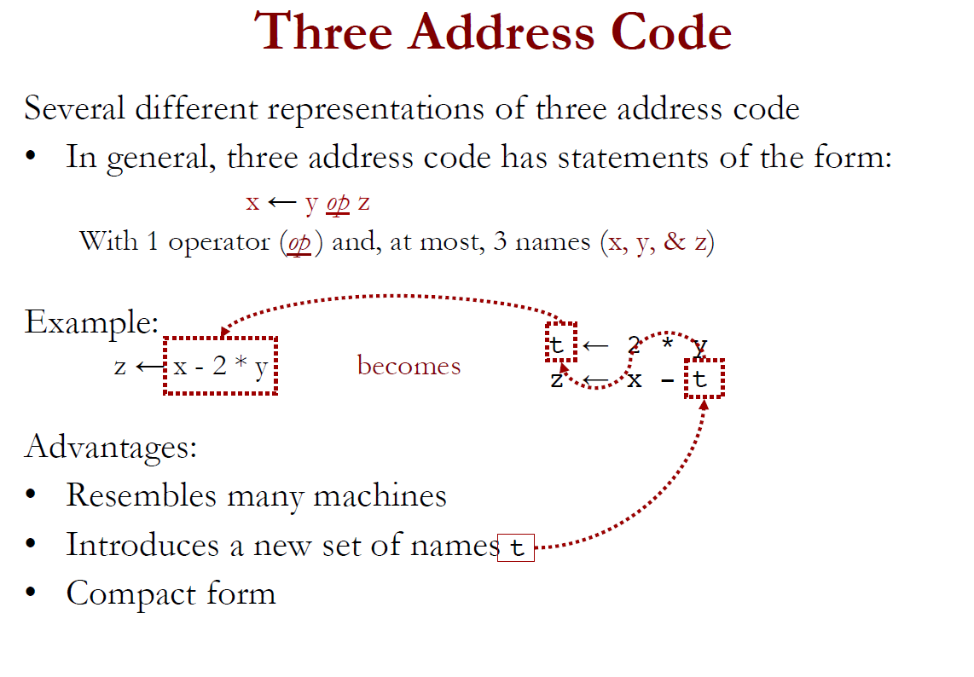

Slide 12
Three Address Instructions

Slide 19
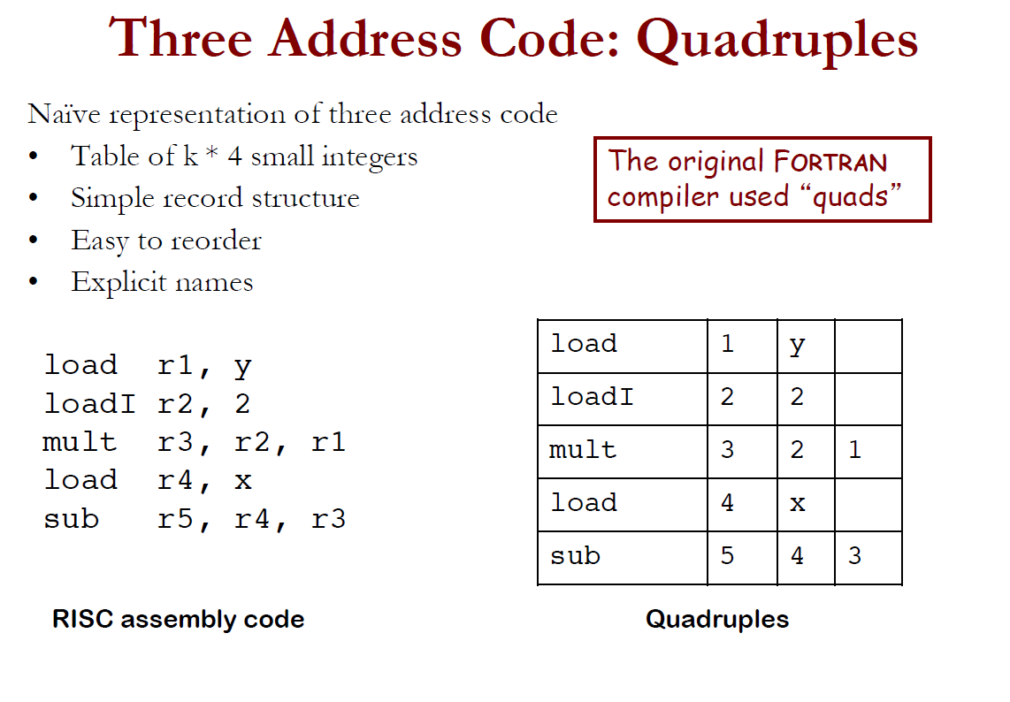

Slide 20
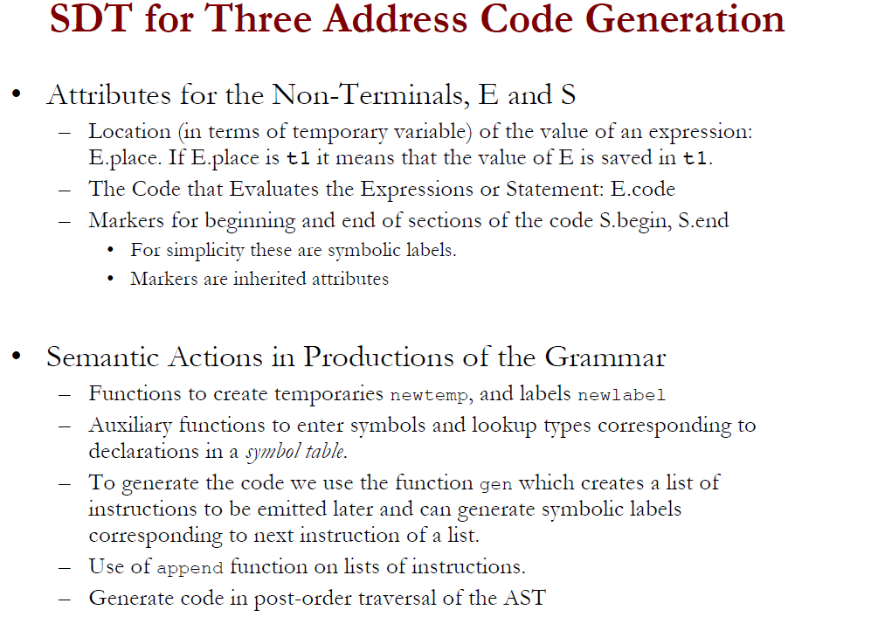

Slide 21
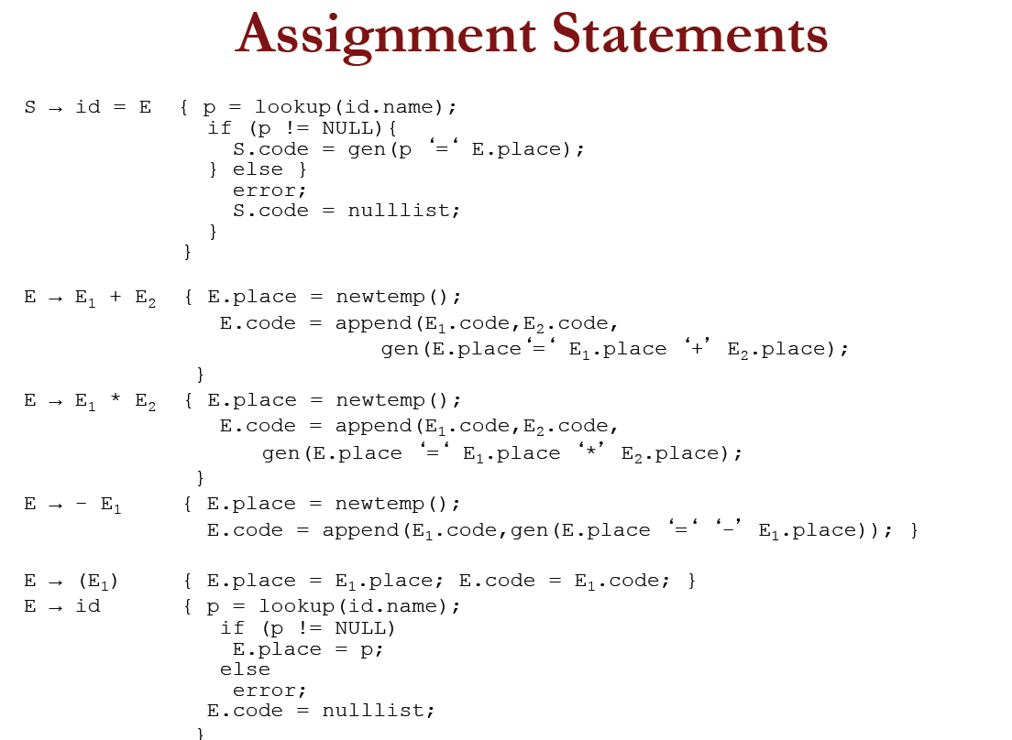

Slide 22
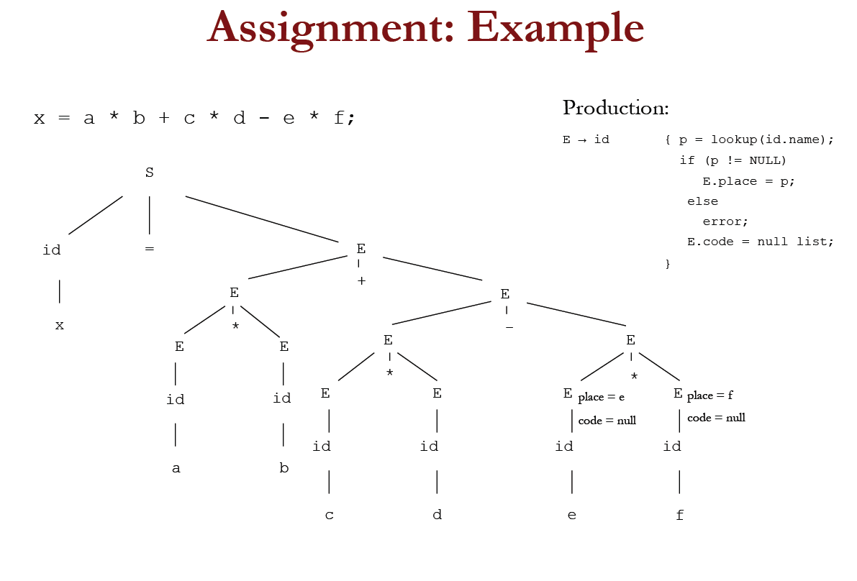

Slide 23
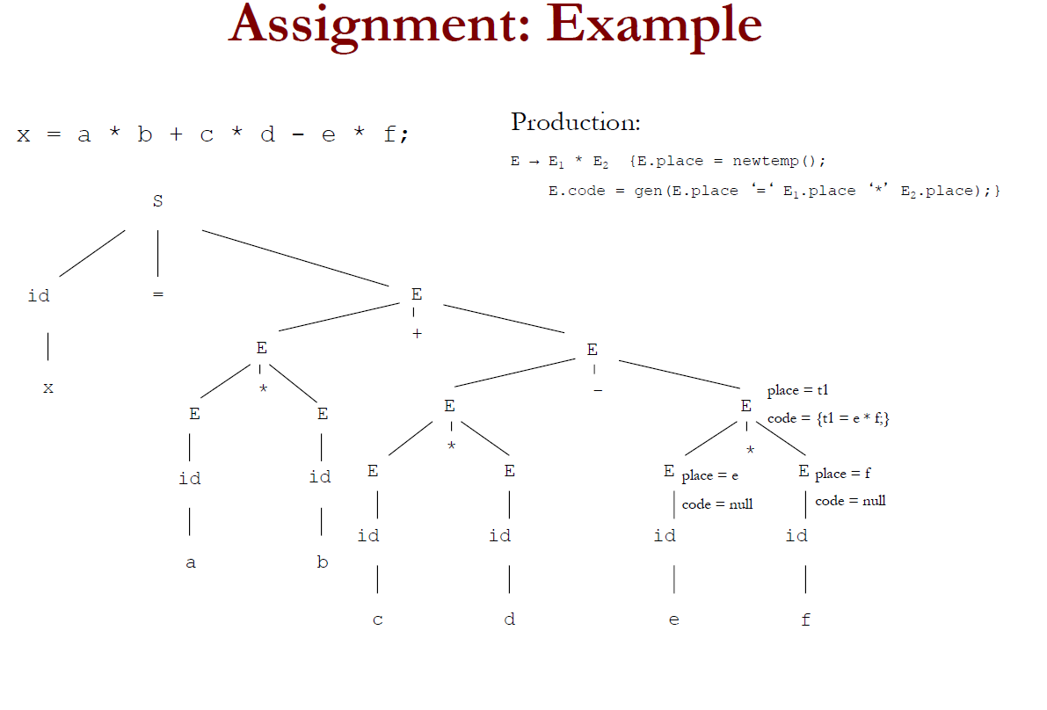

Slide 24
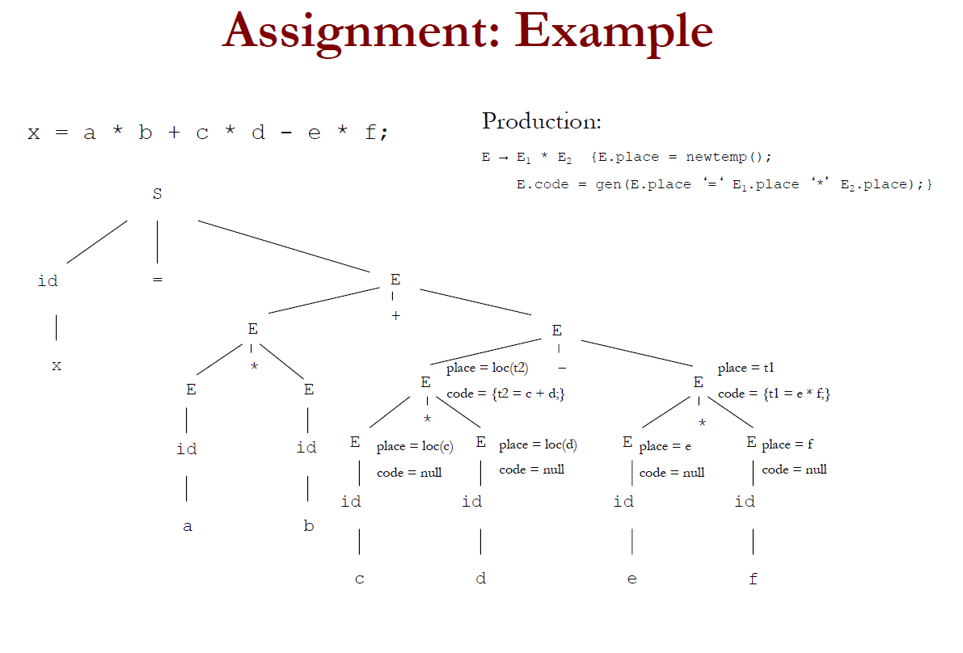

Slide 25
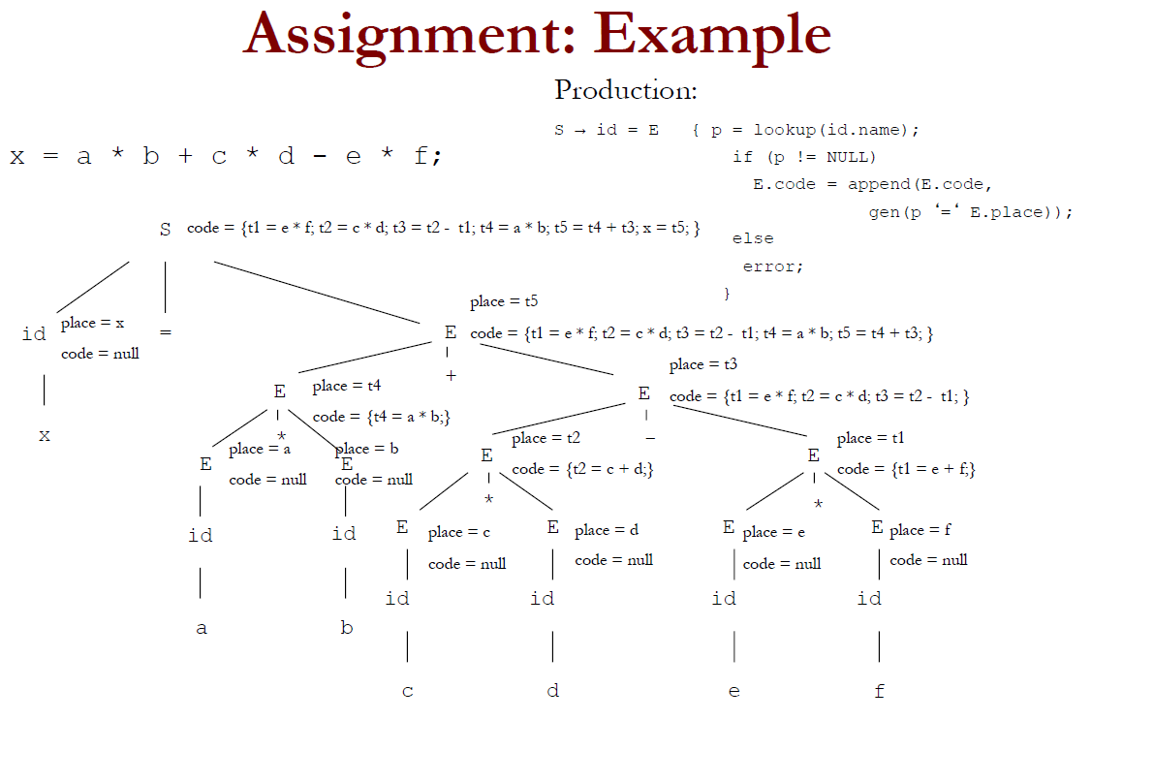

Slide 26
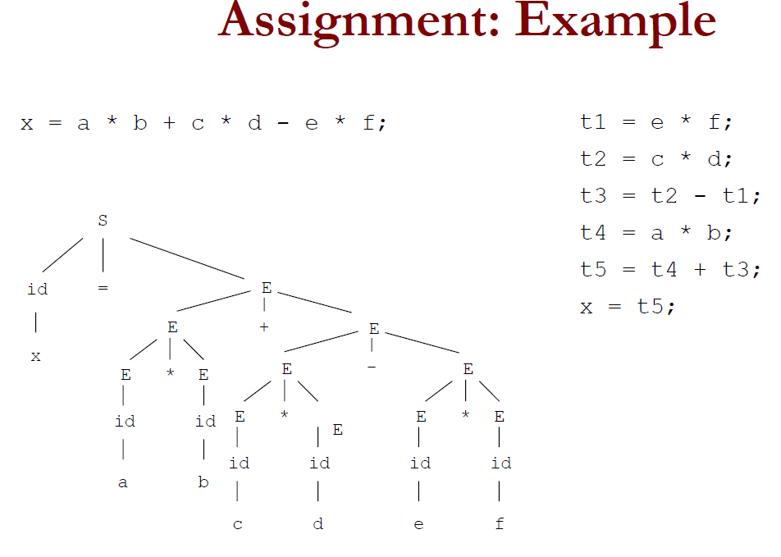

Slide 27
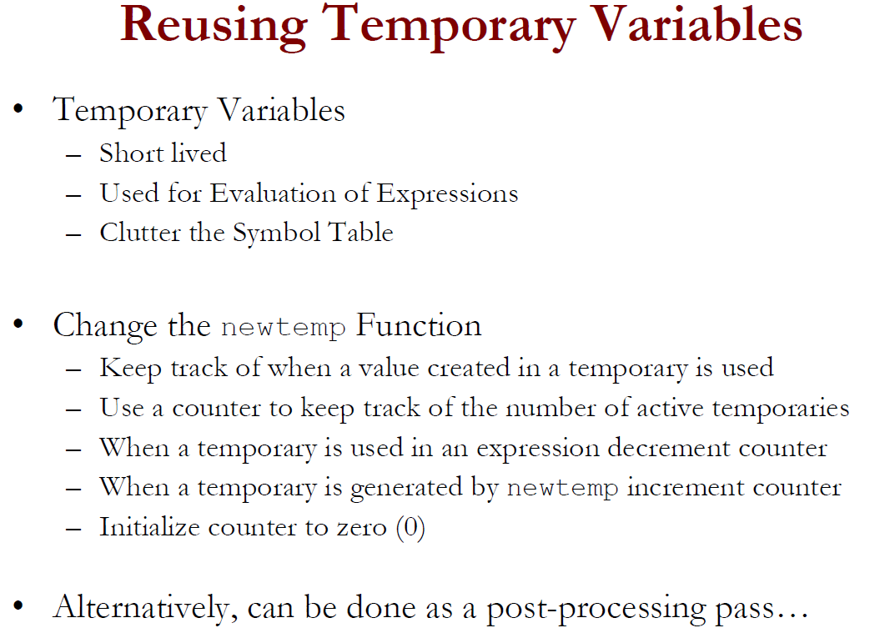

Slide 28
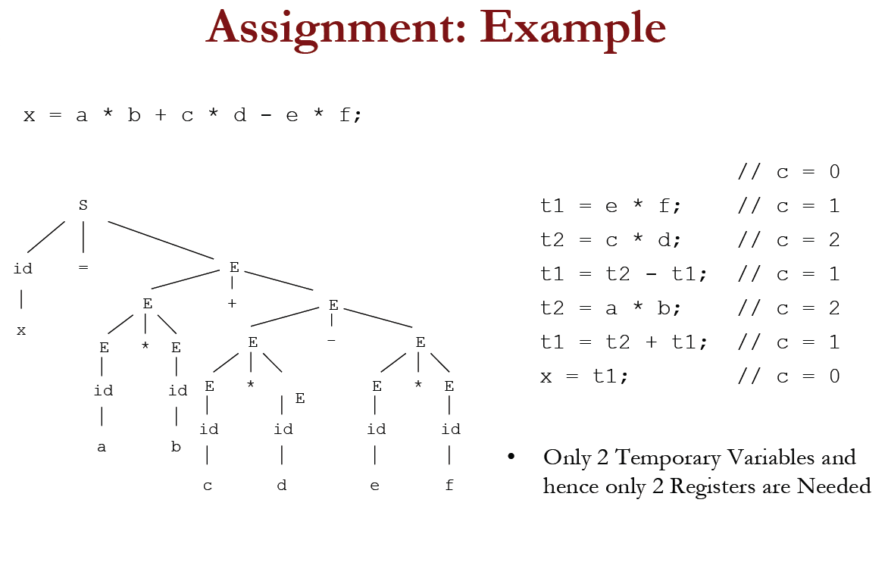

Slide 29
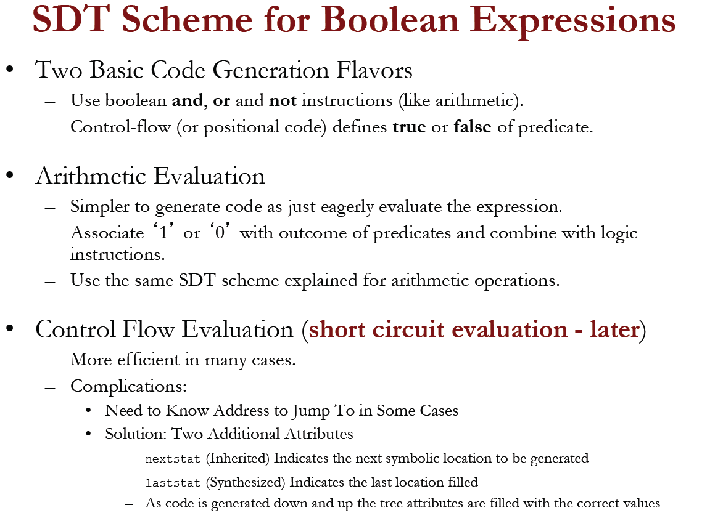

Slide 30
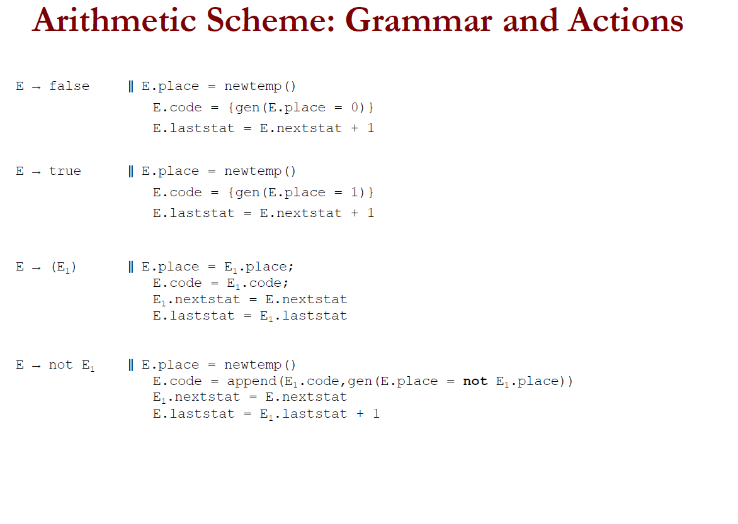

Slide 31
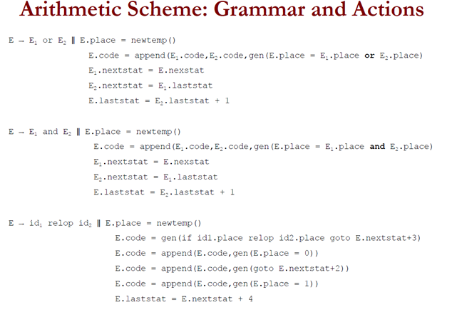

Slide 32
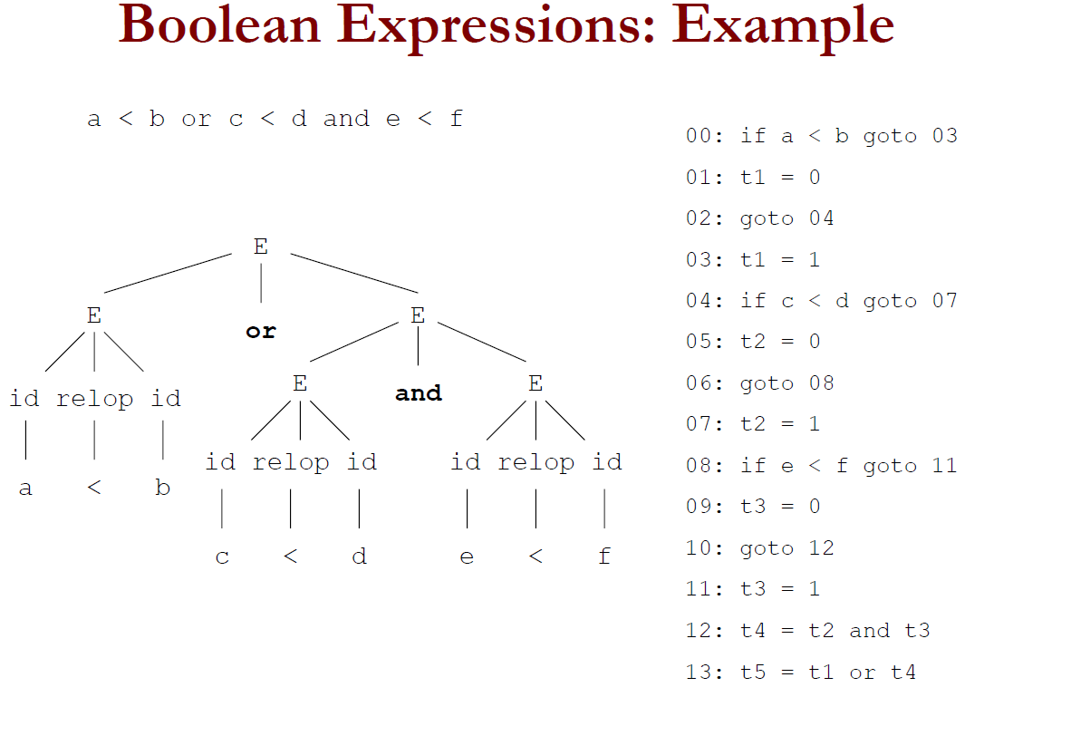

Slide 33
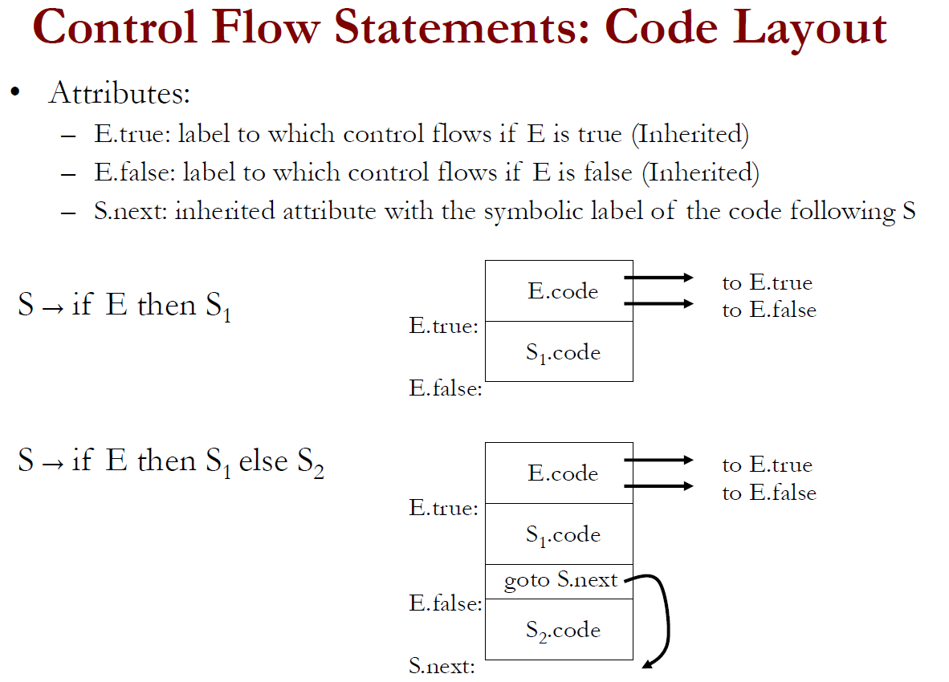

Slide 34
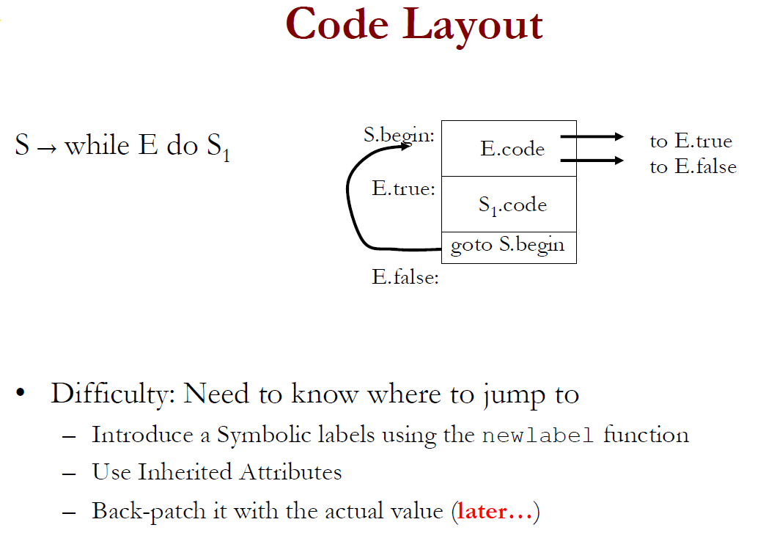

Slide 35
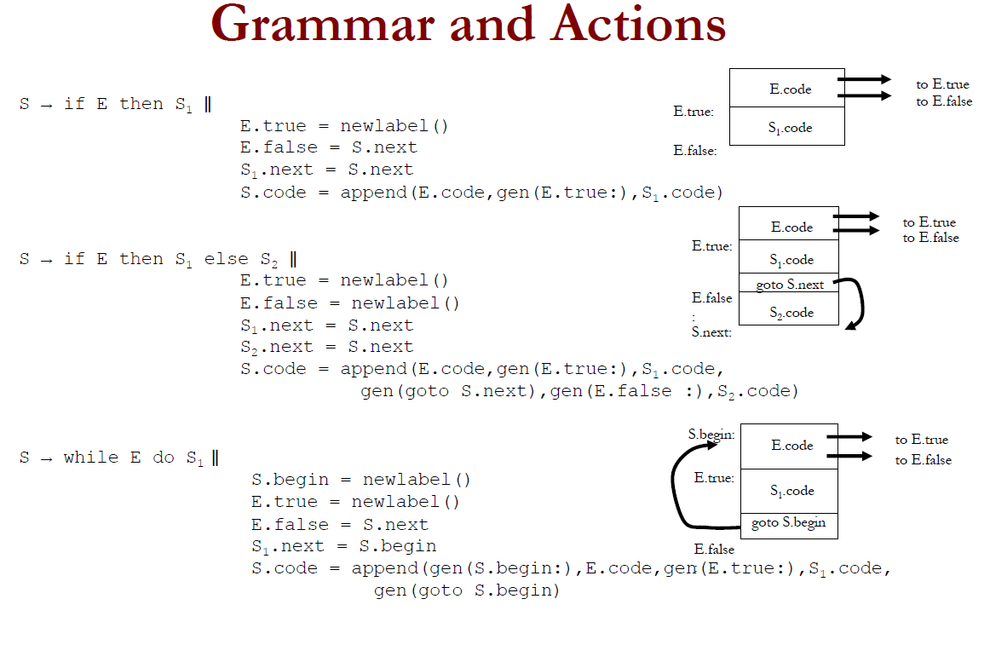

Slide 36
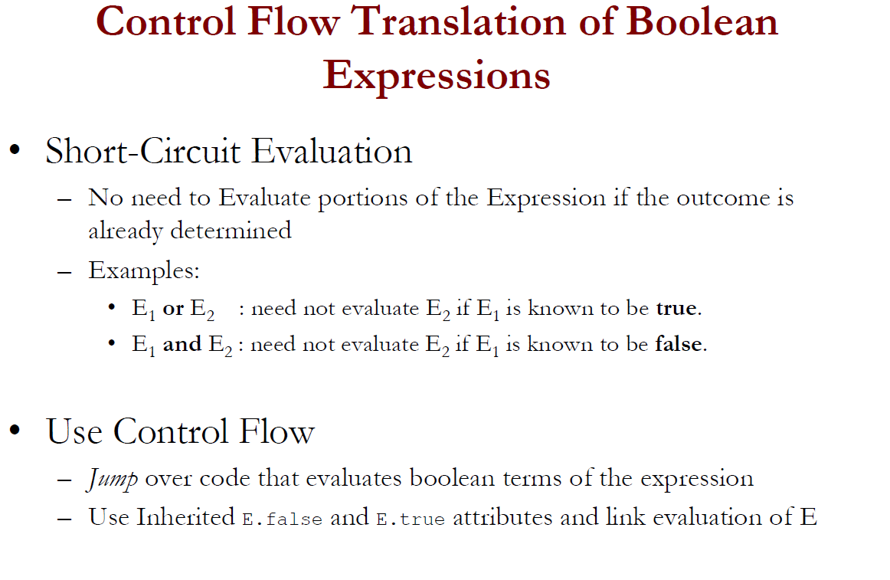

Slide 37
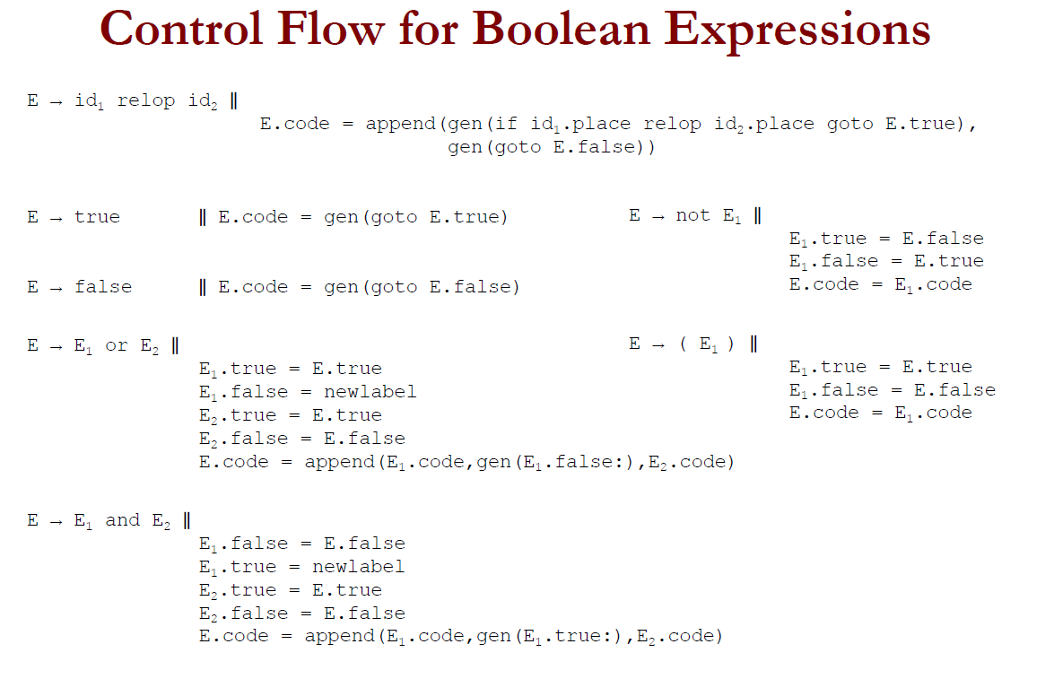

Slide 39
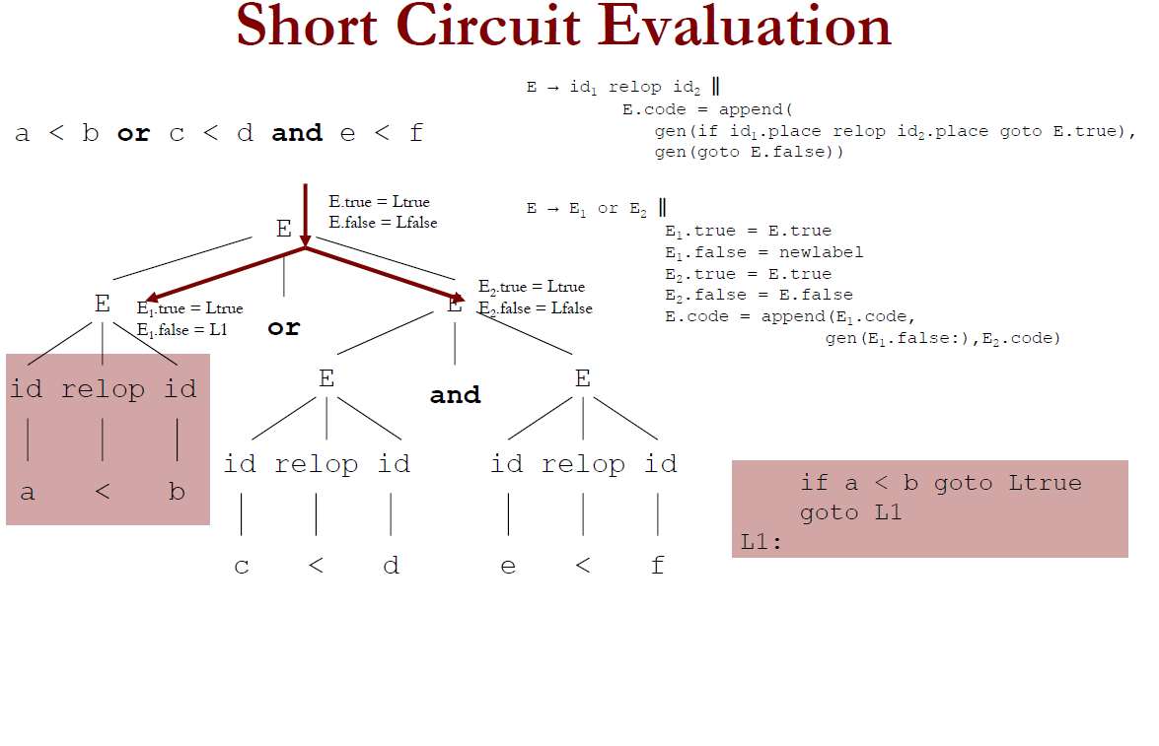

Slide 40
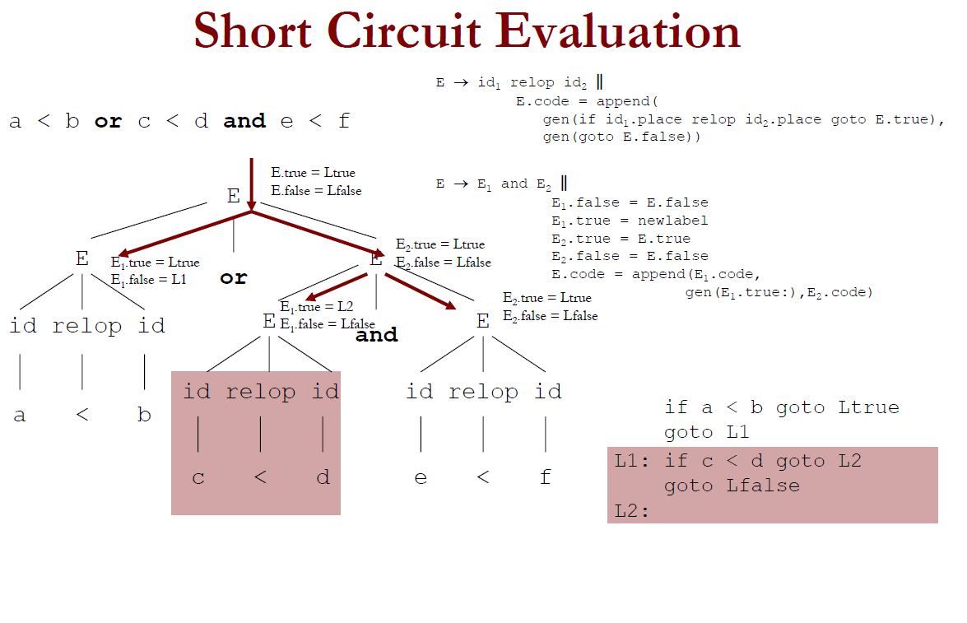

Slide 41
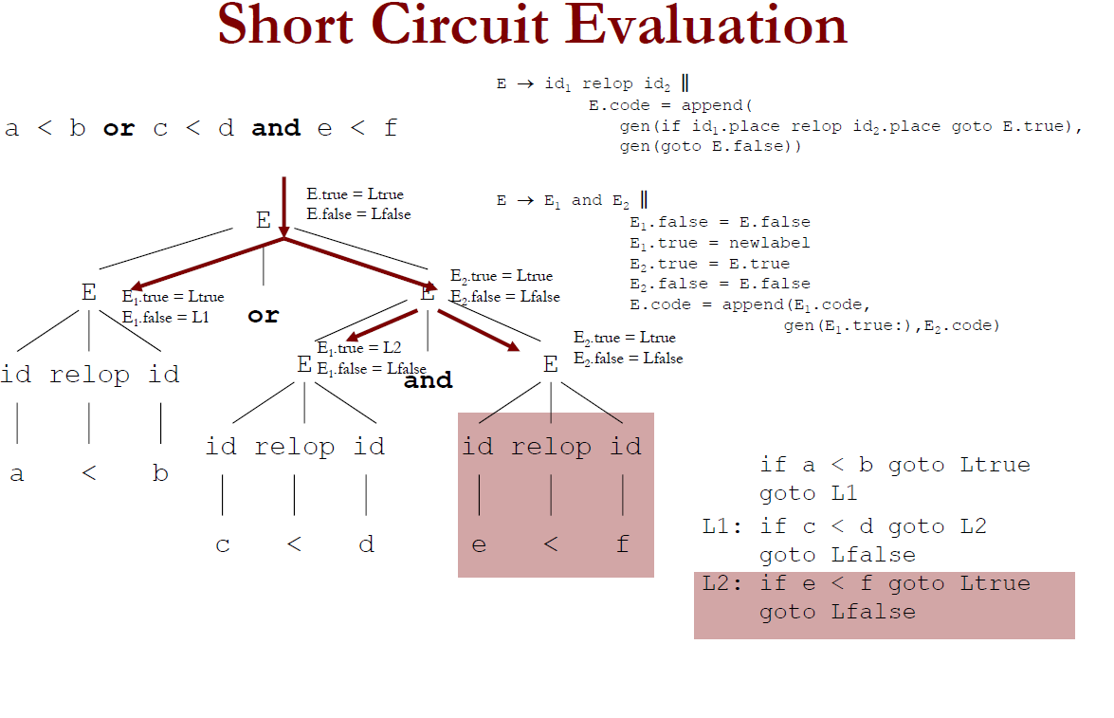

Slide 42
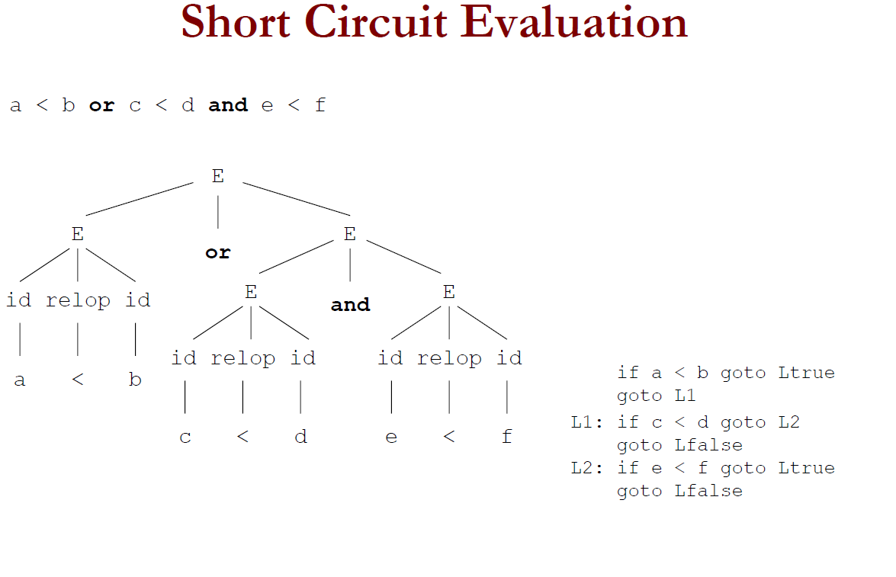

Slide 43
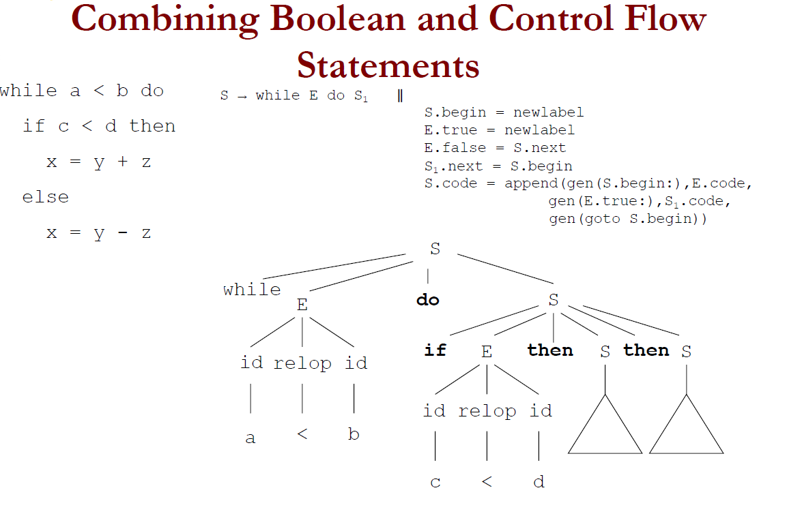

Slide 44
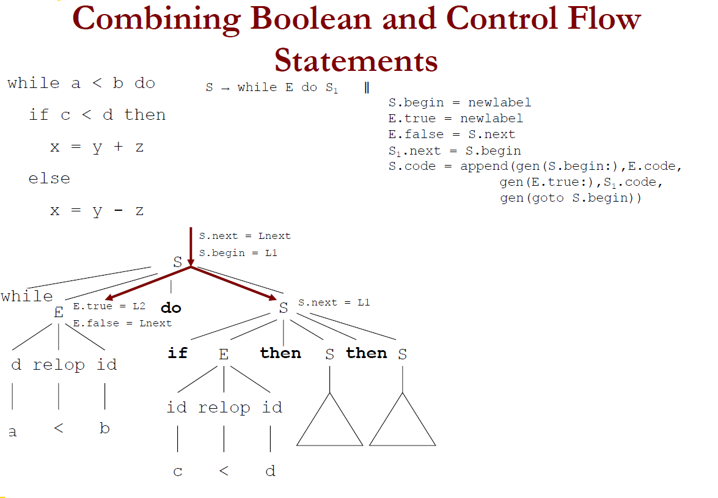

Slide 45
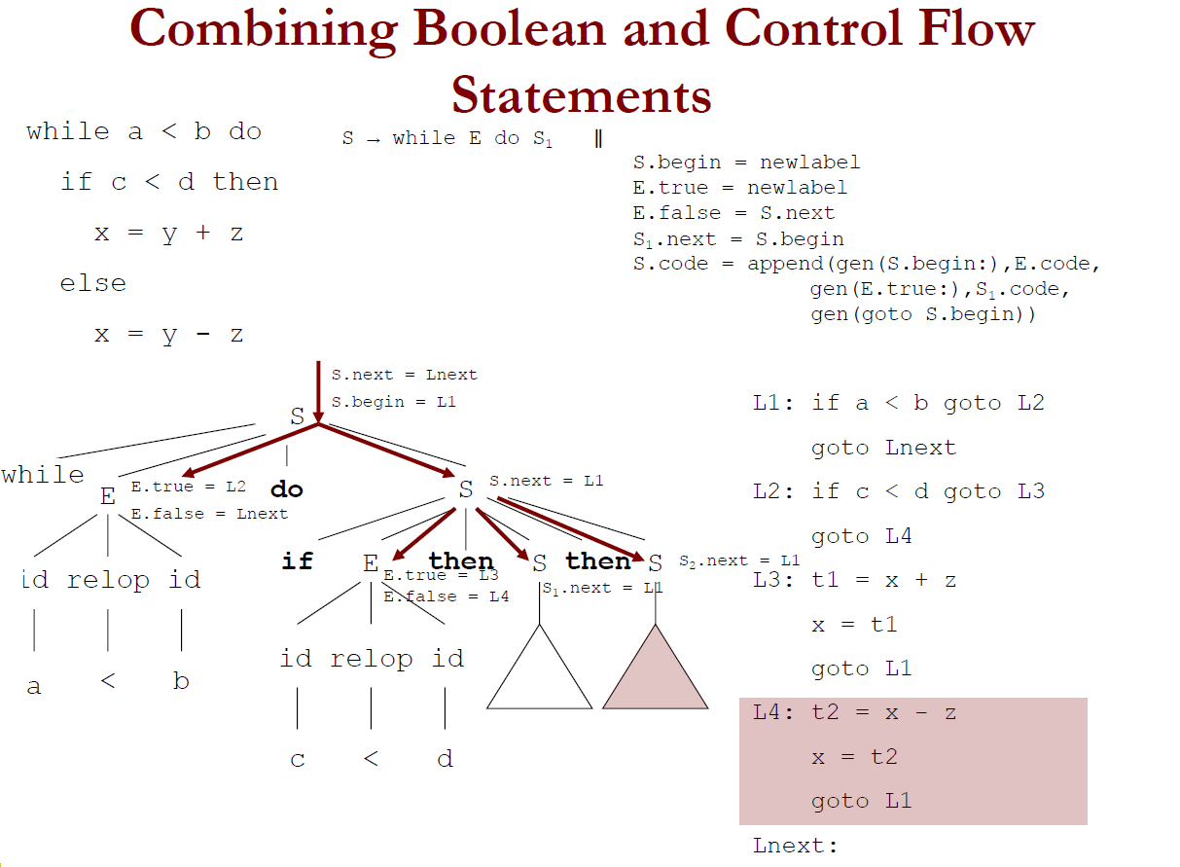

Slide 49
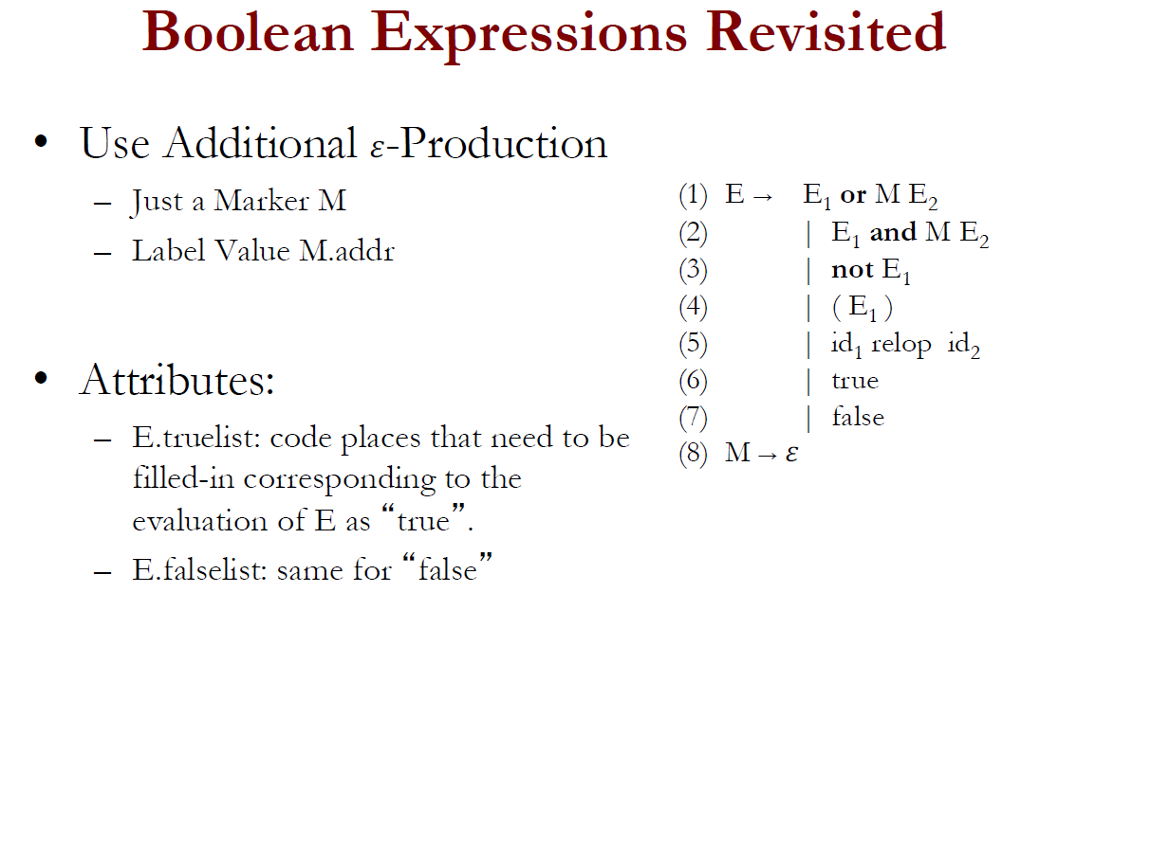

Slide 52
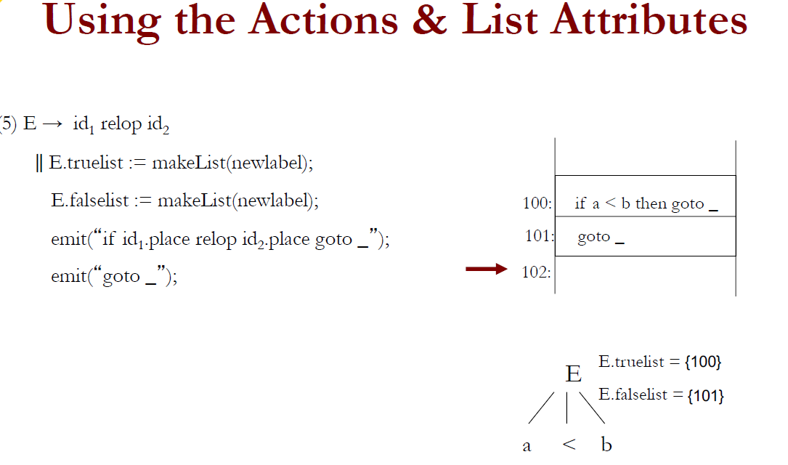

Slide 69
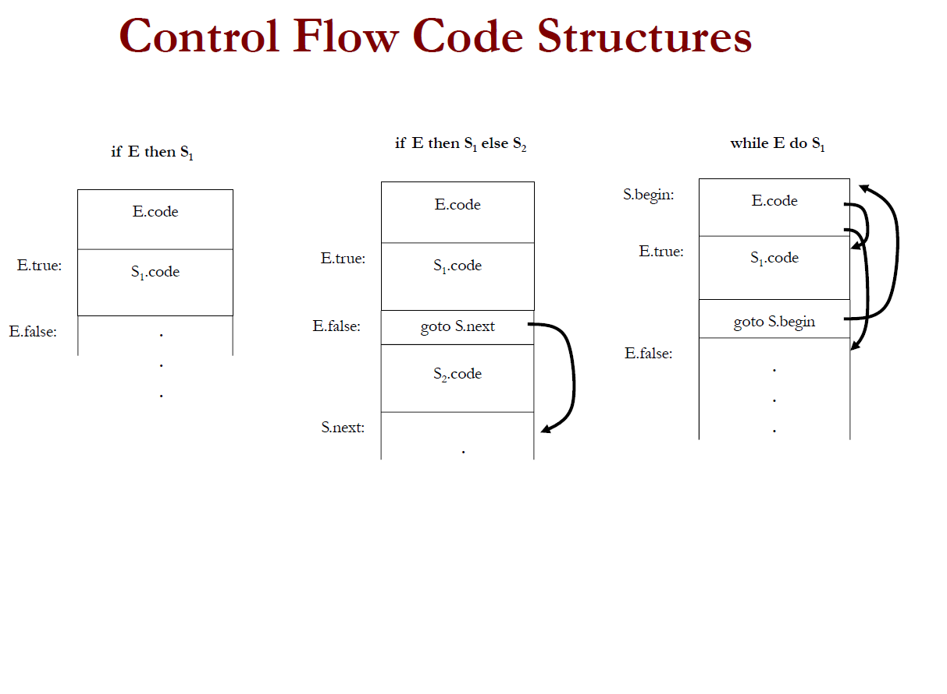

Slide 70
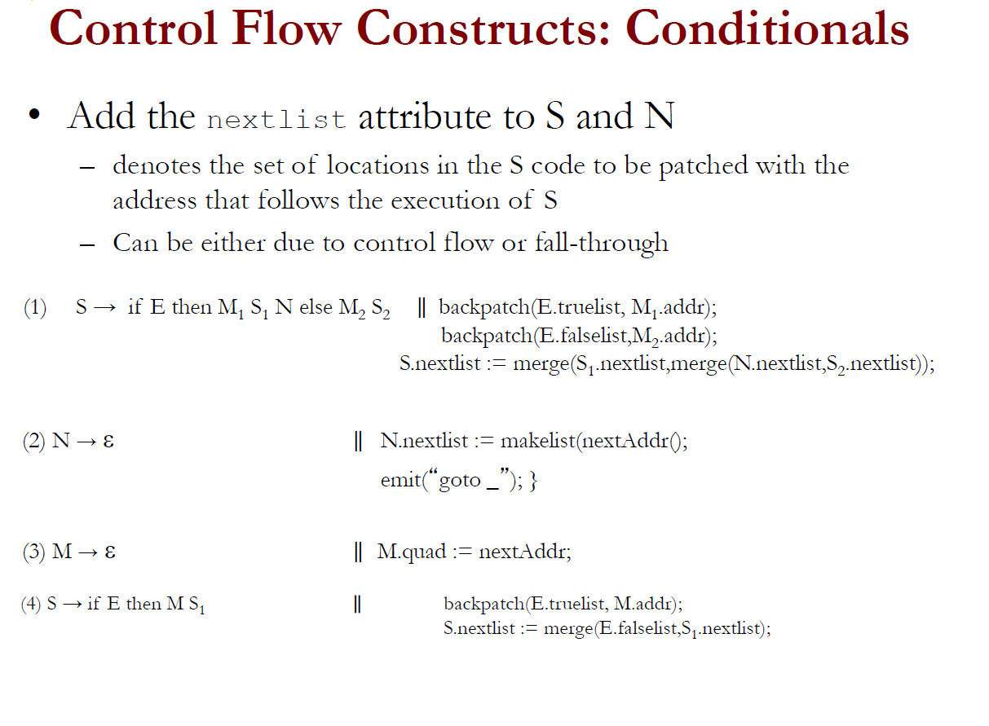

Slide 74
